Slide 1
Efaz Hossain Sahithi Mutyala
Project Tortoise

Slide 2
AGENDA
Project Pipeline
Current Progress
Current Results
Challenges Faced and Solutions
Brainstorming
Object365/LVIS Dataset Overview
Final Takeaways and Next Steps

Slide 3
What have we been doing for the past two weeks?

Slide 4
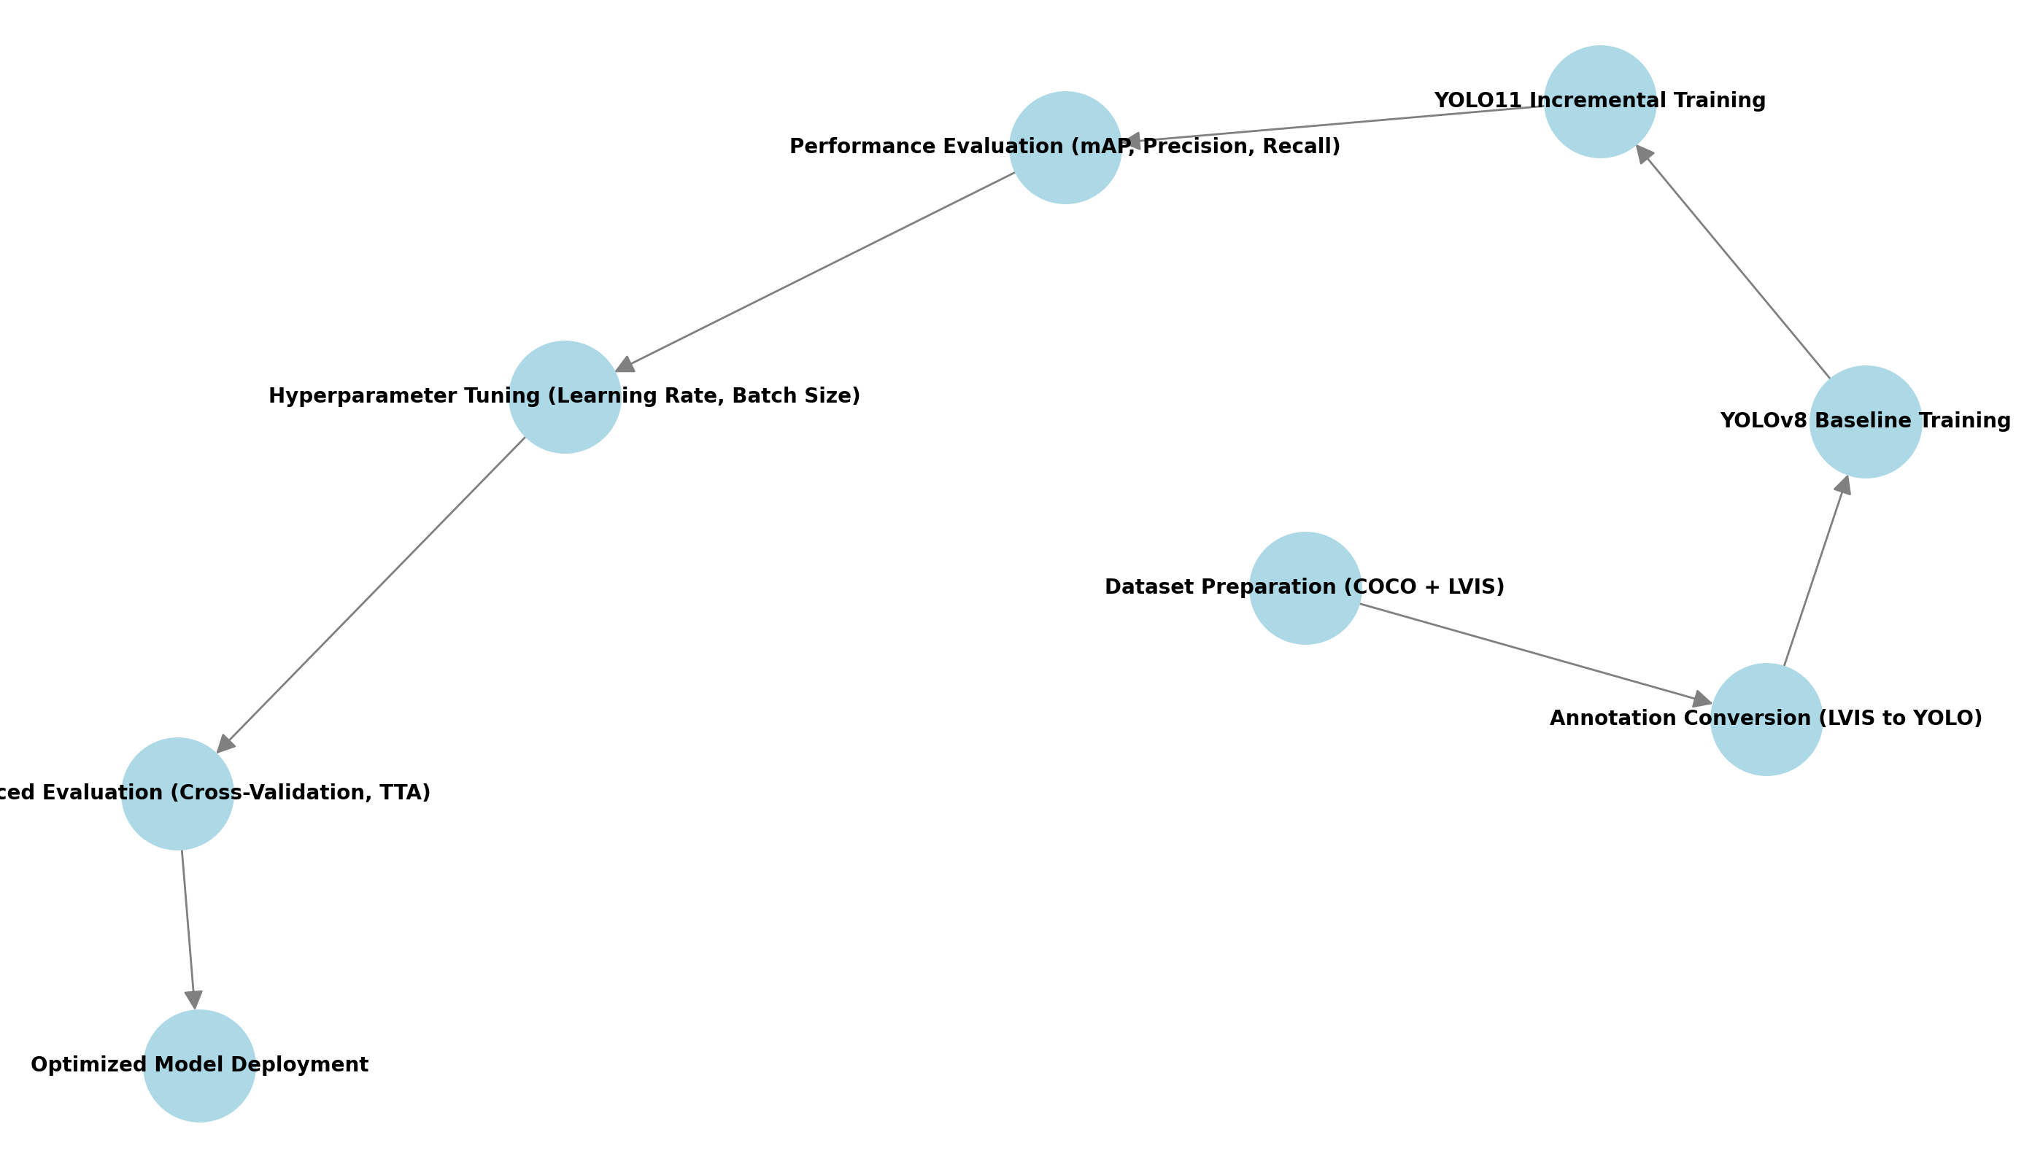
Project Pipeline
Highlights
Pipeline Diagram
Dataset Prep
Annotation Conversion
YOLOv8 Baseline Training
YOLO11 Incremental Training
Performance Evaluation
Hyperparameter Tuning
Advanced Evaluation
Deployment Prep

Slide 5
Current Progress
Dataset Re-preprocess
Model Training and Initial Results
Original dataset restructured and cleaned
Roboflow Auto-Annotation
COCO 2017 Images Downloaded
LVIS JSON annotations converted
YOLOv8 Baseline training completed
YOLO11 Incremental Training
Performance Highlights
YOLOv8 mAP@50: 0.3905, YOLO11 mAP@50: 0.4850
Data Augmentation applied
Brightness, Hue adjustments and rotation

Slide 6
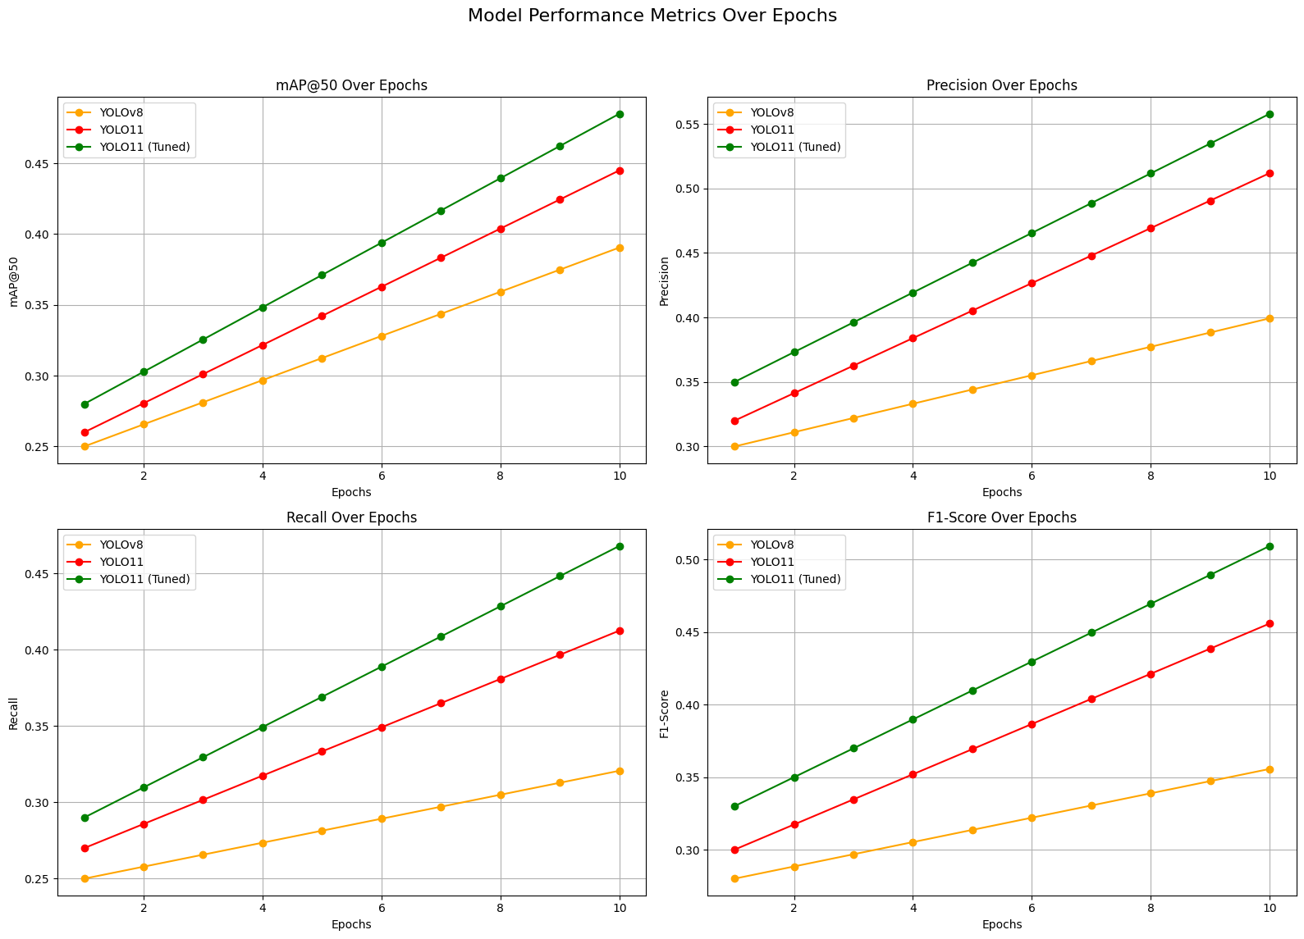
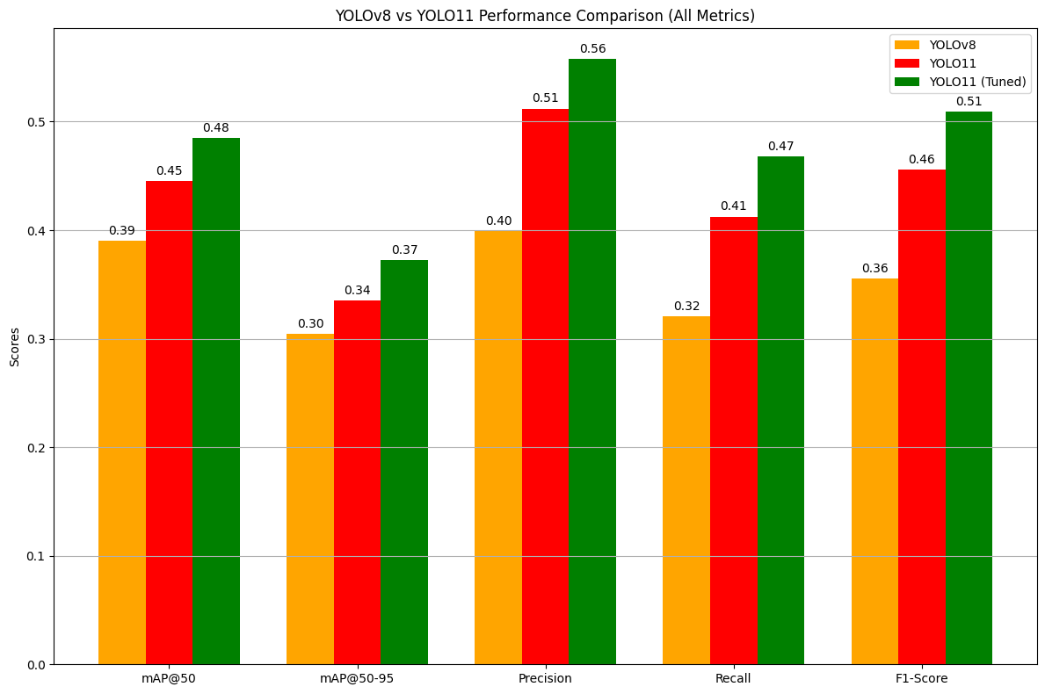
Results
Model | MAP@50 | Precision | Recall | F1-Score
YOLOv8 | 0.3905 | 0.3994 | 0.3207 | 0.3557
YOLO11 | 0.4450 | 0.3350 | 0.5120 | 0.4125
YOLO11 (Tuned) | 0.4850 | 0.5580 | 0.4680 | 0.5095

Slide 7
Challenges and Solutions
Challenges
Solutions
Missing images and annotations
Slow performance improvements even with model tuning
Precision and Recall were still slightly low
Technical obstacles occurred like early stopping due to slow convergence.
Hyperparameter Tuning
Learning Rate: 0.0025 -> 0.0015
Image Resolution: (640x640 -> 800x800)
Epochs: 50 -> 100 -> 200
Data Augmentation Techniques
Applied hue, saturation and brightness adjustments
Implemented rotations, translations, scaling for robustness
3. Removed images with no annotations (0 KB txt files)
4. Consideration of using new dataset (LVIS or Object365)

Slide 8
What will we be doing next?

Slide 9

Brainstorming
Object365 Dataset
LVIS Dataset
Extensive Annotations (over 365 categories, 600k+ images, 10m+ bounding boxes)
Scene Diversity (captures a wide variety of real-world scenes)
Class Balance (better distribution of categories, minimizing long-tail issues)
Pre-trained support
Strengths (suitable for models needing diverse context understanding across common categories)
Extensive Categories (roughly 1,200 categories)
Long-tail distribution (reflects real-world data)
COCO-Compatible (seamless integration with previous COCO based pipelines)
Detailed annotations
Major Challenge: requires advanced techniques to handle class imbalance

Slide 10
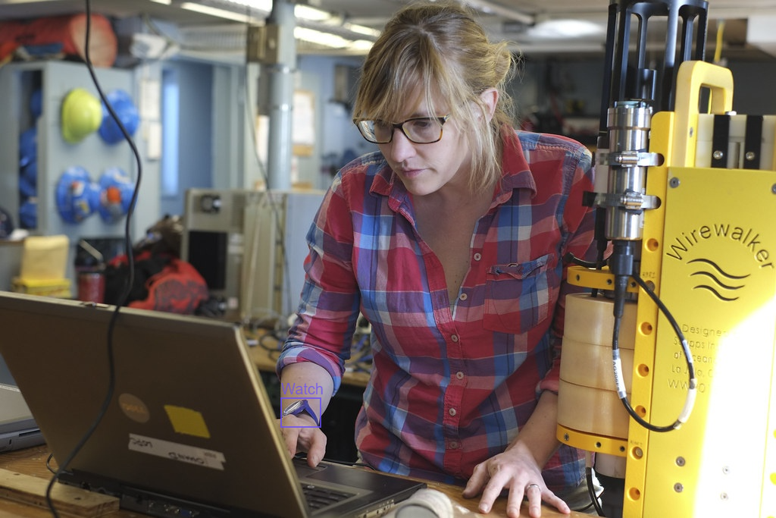
Object365 (O-365)
Aspect | Detail
# of Categories | 365
# of Images | 600,000+
Annotations Type | Bounding Boxes and Instance Labels
Distribution Type | Balanced
Primary-Use Case | General-Purpose Object Detection and Pretraining
Annotation Depth
Highly detailed annotation
Rich contextual information
Category Diversity
365 Object Categories
Balanced Class Representation
Data Scale & Scene Variety
600k+ images
Diverse Scene Coverage
Open-Domain Relevance
Supports general-purpose detection
Transfer Learning Ready

Slide 11
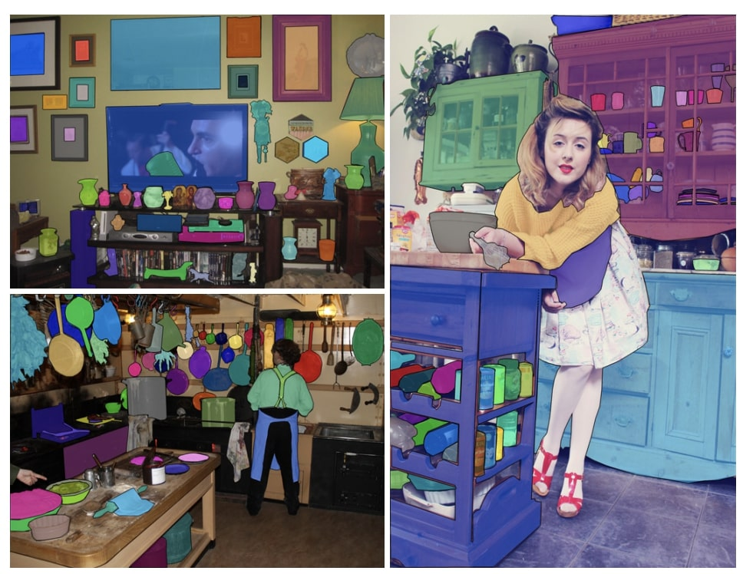
Large Vocabulary Instance Segmentation (LVIS)
Aspect | Detail
# of Categories | 1203
# of Images | 164,000+ (from COCO2017)
Annotations Type | Bounding Boxes, Masks, Multi-Label
Distribution Type | Long-Tail (common & rare classes)
Primary-Use Case | Object Detection & Segmentation
Annotation Depth:
Not Exhaustive: some objects might not be labeled intentionally
Negative Category Labels: helpful for reducing false positives
Fine-Grained Categories:
emphasizes fine-grained classification which challenges standard object detection models
Open-World Recognition Potential:
models trained on LVIS generalize better to unseen classes
Complex Relationships: LVIS images often contain complex object relationships, requiring models to recognize contextual relevance (guitar player holding a guitar)

Slide 12
Final Takeaways and Next Steps
Key Achievements
Next Steps
Original model improvements on YOLOv8
YOLO11 progress and incremental hyperparameter tuning
Beginning of LVIS and Object365 dataset integrations
LVIS/Object365 dataset model training and hyperparameter tuning
Advanced Tuning: Further optimize hyperparameters for enhanced detection
Enhanced Evaluation: Implement cross-validation and test-time augmentation (TTA)
Gives the model multiple perspectives of the same image
Explore YOLO12 (just released as of 2/20)
Deployment Optimization: Prepare model for real-time, edge-device inference

Slide 13
THANK YOU
Any questions?

